Slide 1
404 NOT FOUND
Group Members:
Wong Wai Lum (GL)
Allycia Chin Jia Hui
Chai Yong Hin
Gigi Yip Zhi Qi

Slide 2
CHALLENGE 01
DIGITAL HERITAGE AND TOURISM

Slide 3
PROBLEM STATEMENT
❌ Tourists often lack an engaging way to explore and learn about Malaysia’s top destinations. ❌ Traditional travel websites are static, text-heavy, and offer limited interaction. ❌ There is no easy way for users to track places they’ve visited or plan trips interactively.
✅ Solution:
Interactive and educational
Visually engaging and easy to navigate
Able to track user travel progress (digitally)
Designed to promote tourism through gamified learning

Slide 4
SOLUTION
Develop a website to promote Malaysian cultural heritage
Includes interactive features such as:
A visually appealing homepage
An Immersive Cultural Exploration with 360° Street Views and Travel Tips
Engaging gamifications like puzzles, quiz, and memory game
A digital passport feature showcasing some of the most famous and often visited areas in Malaysia.

Slide 5
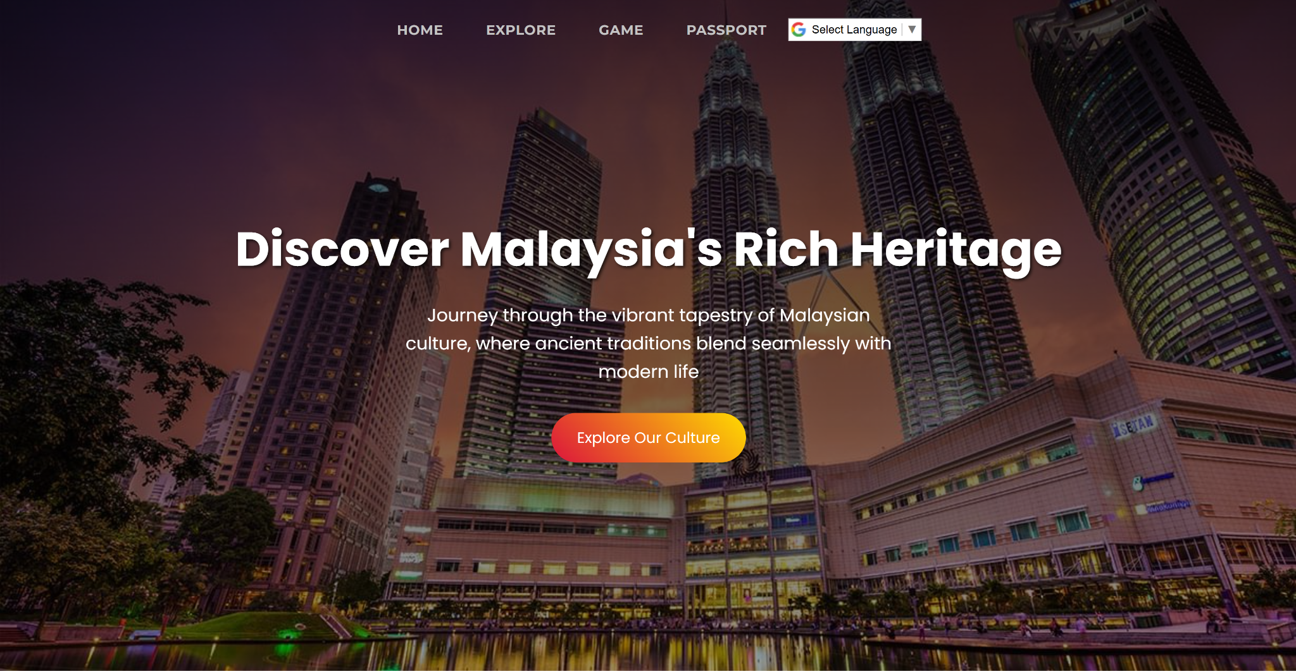
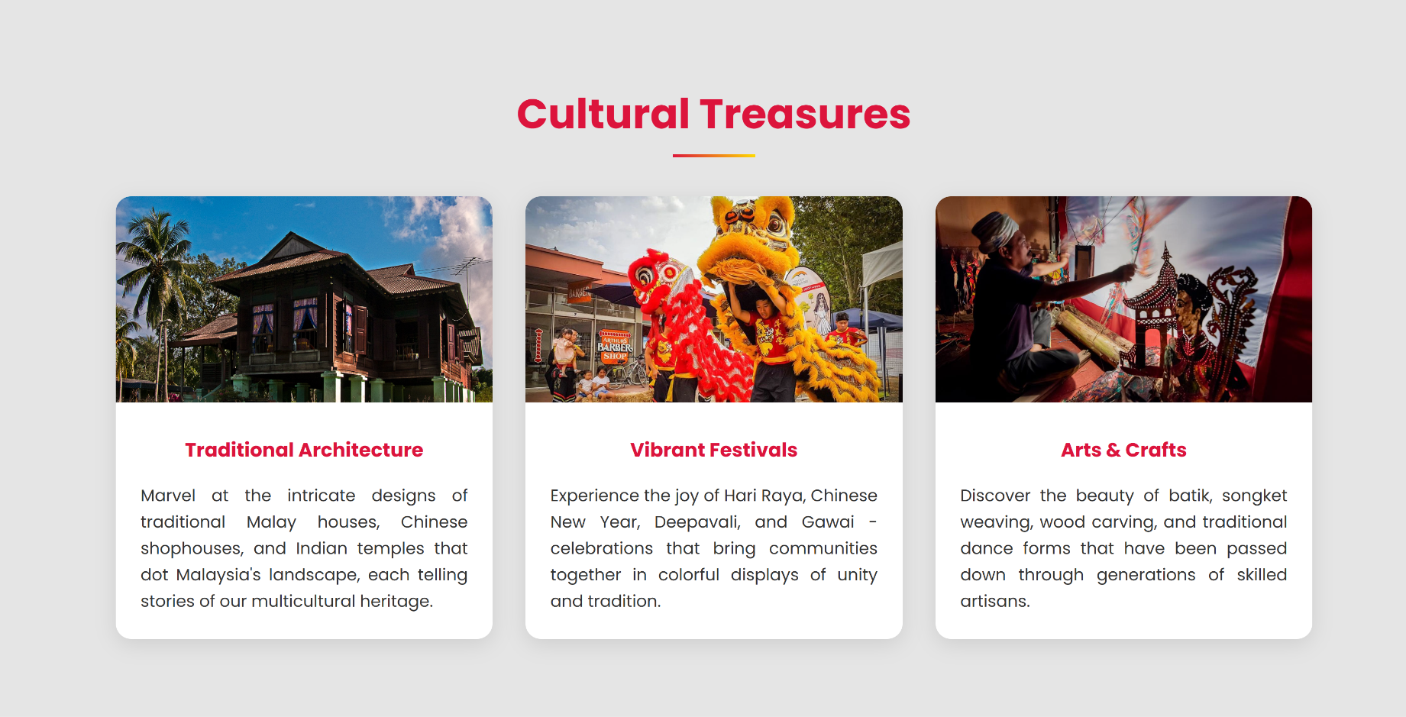
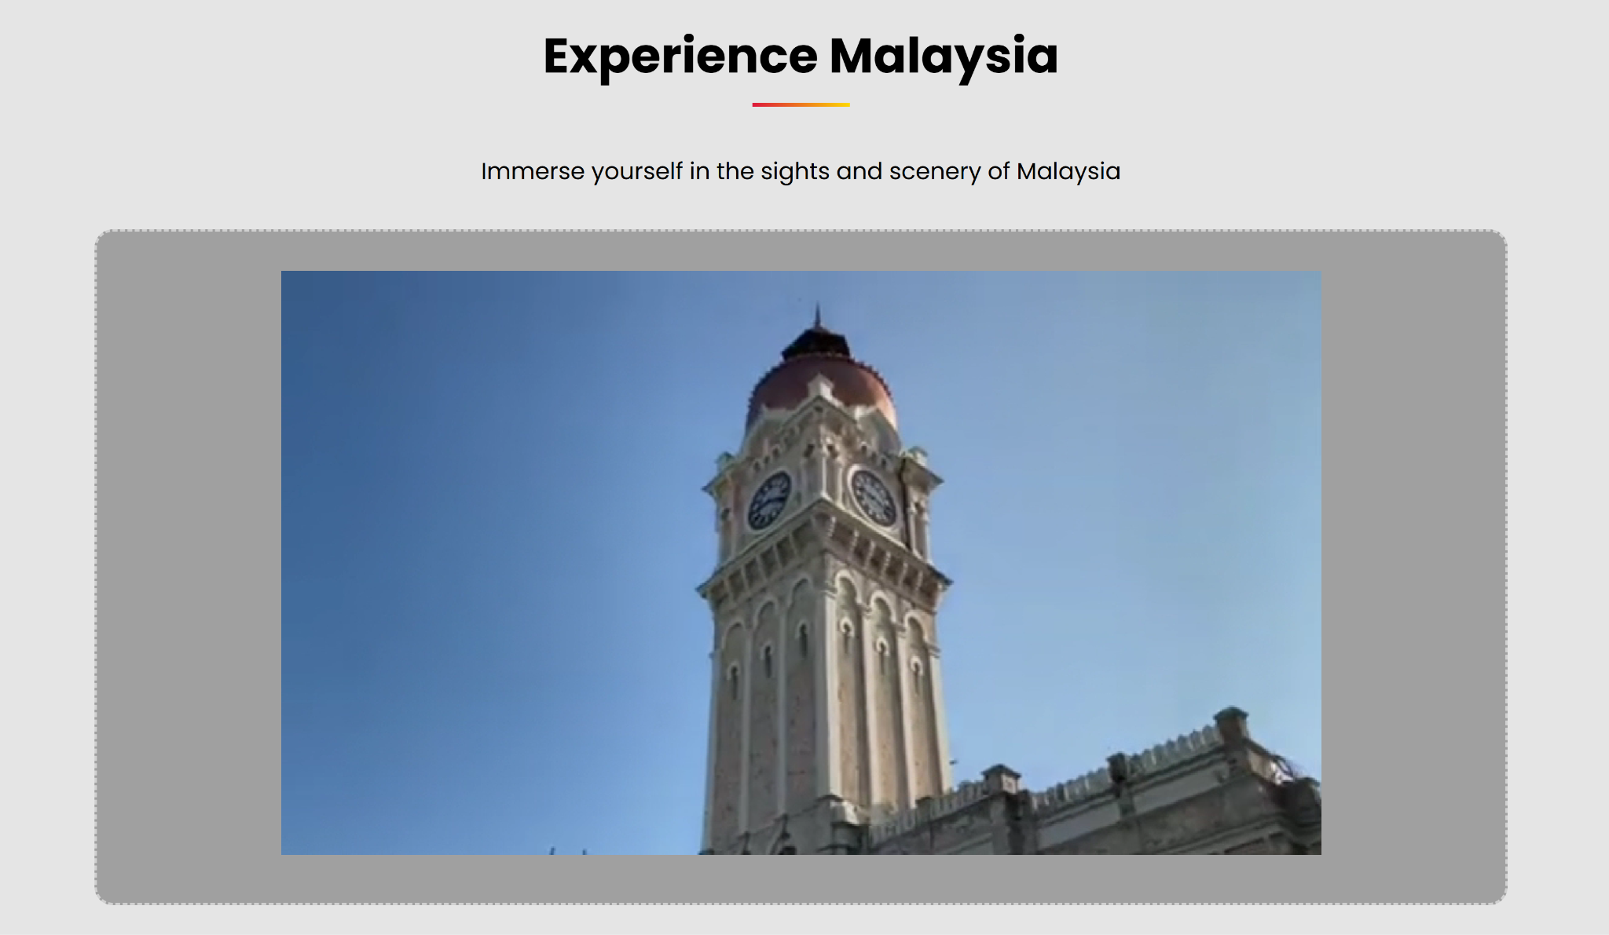
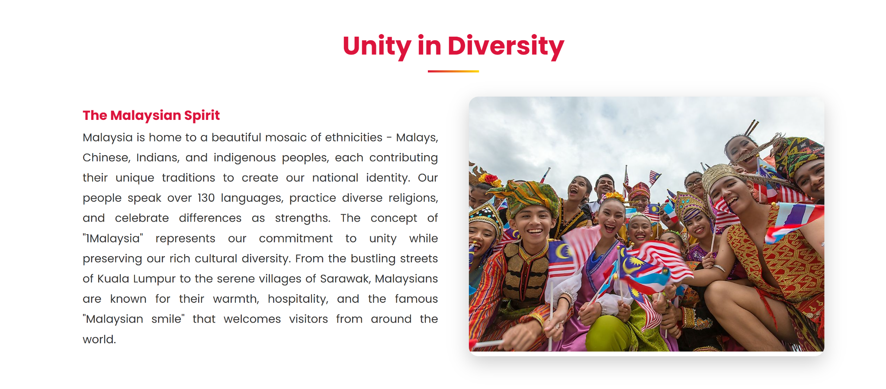
Home Page

Slide 6
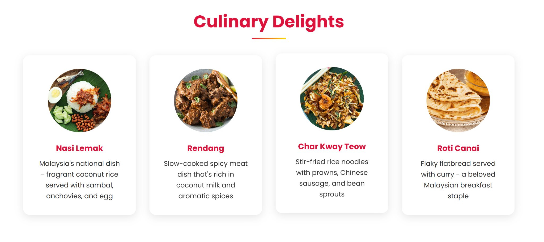
Home Page

Slide 7
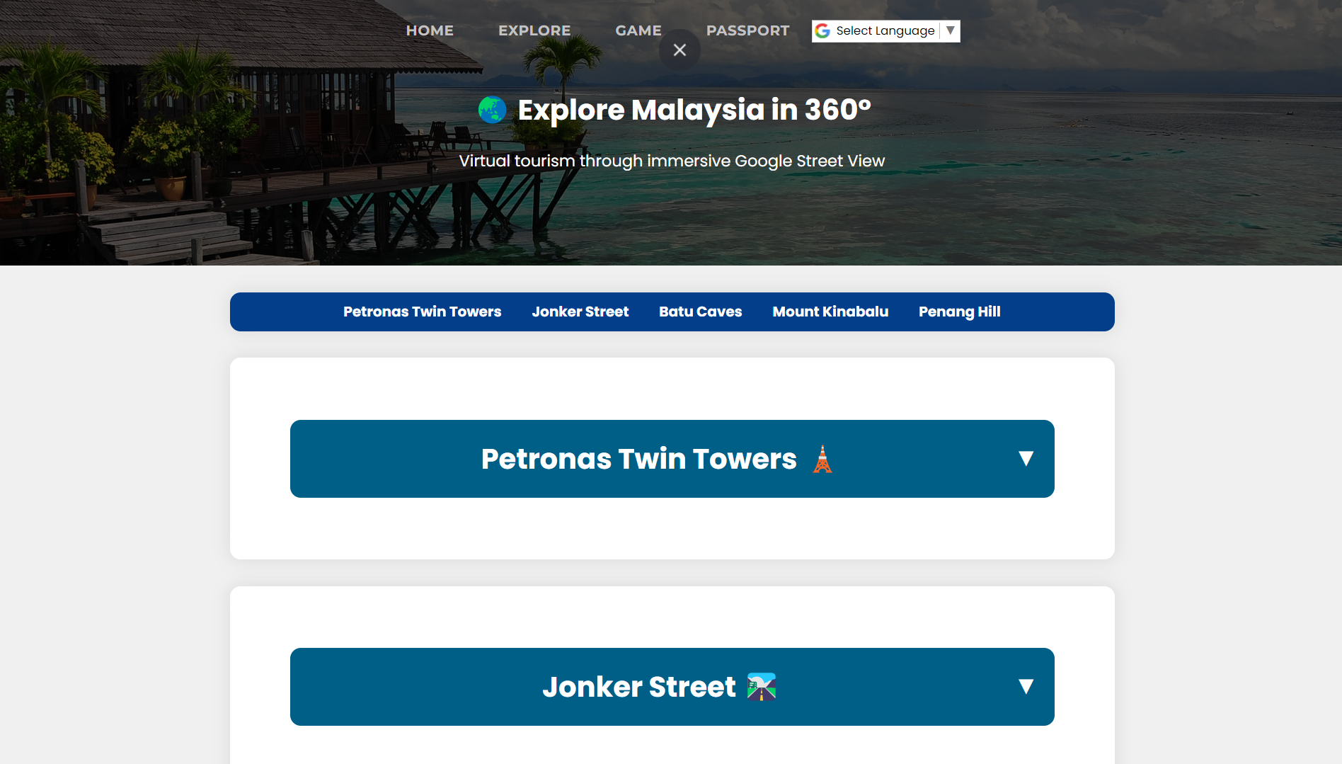
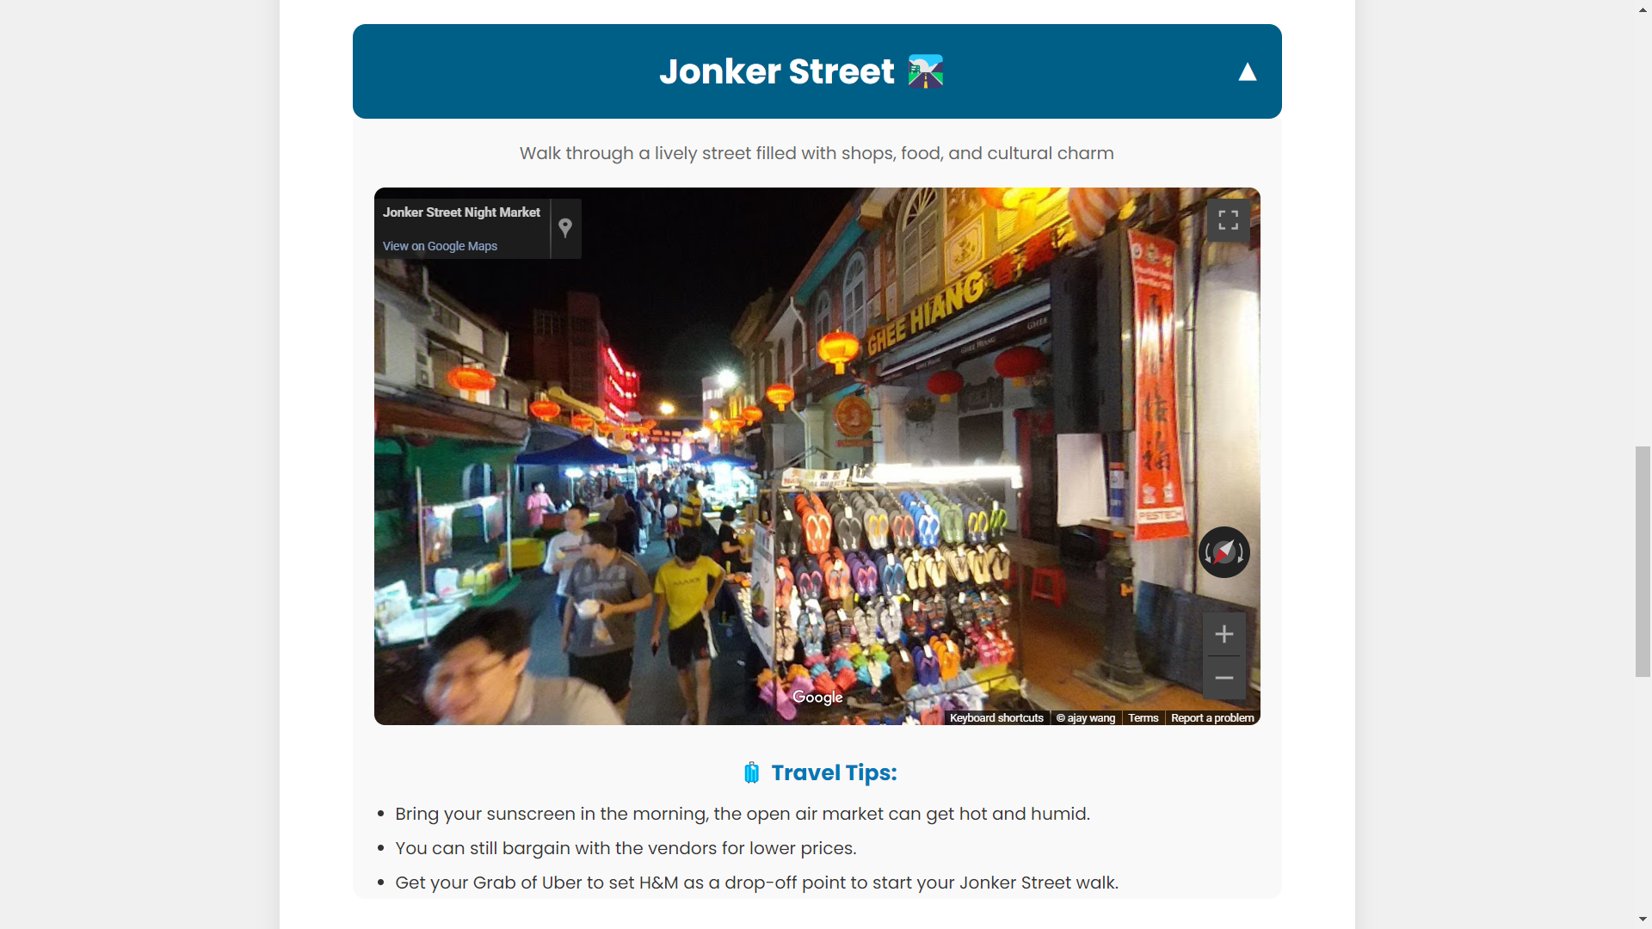
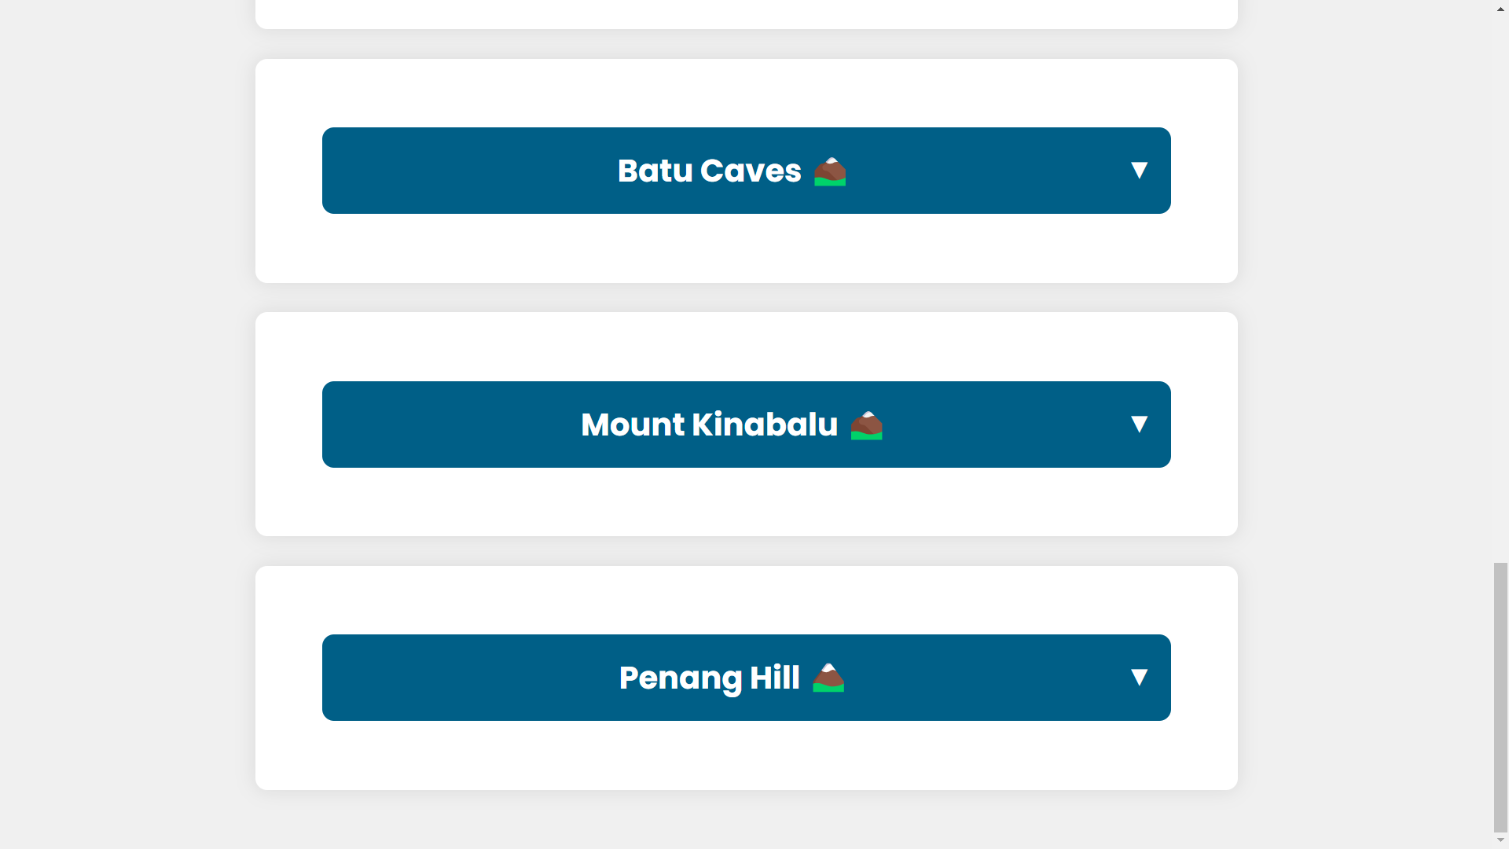
Explore

Slide 8
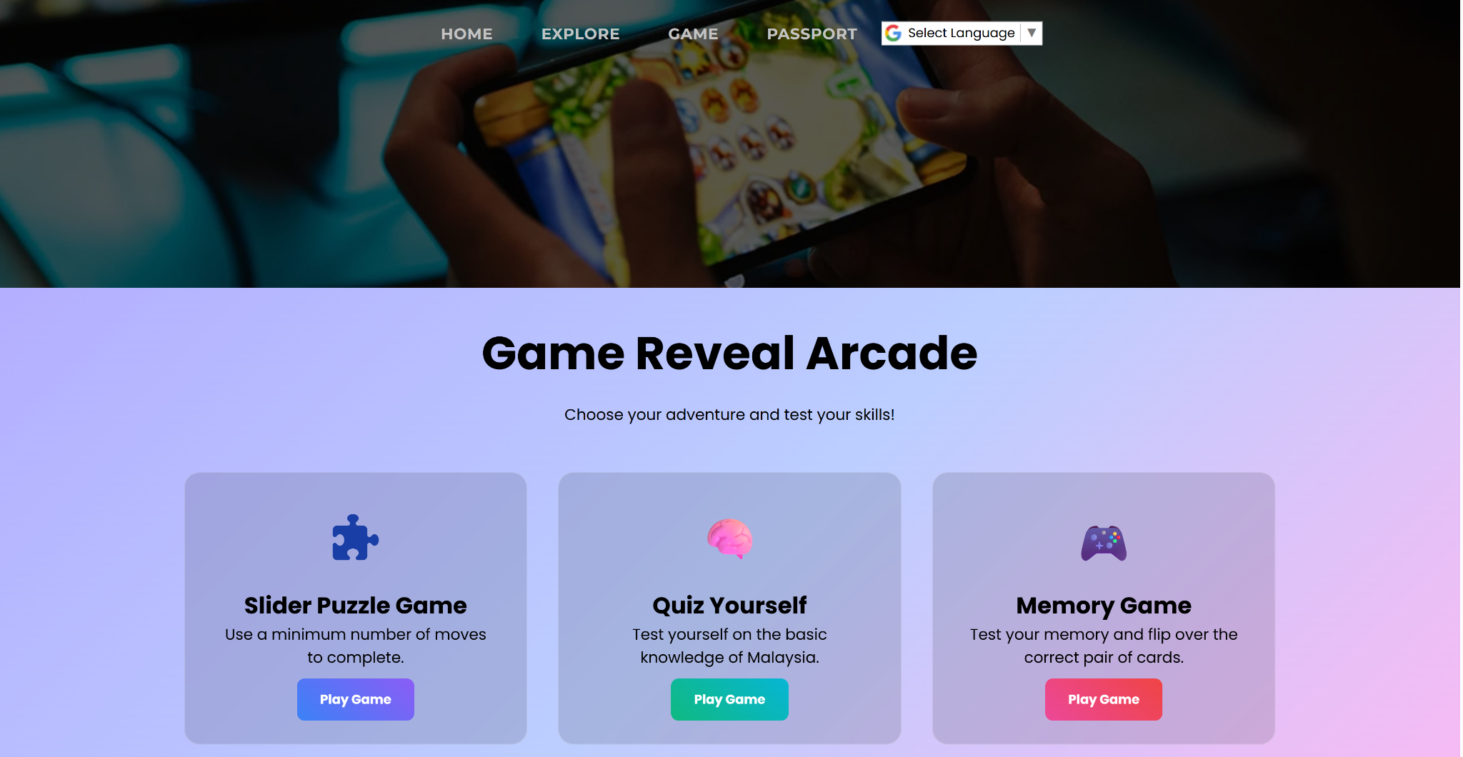
GAME

Slide 9
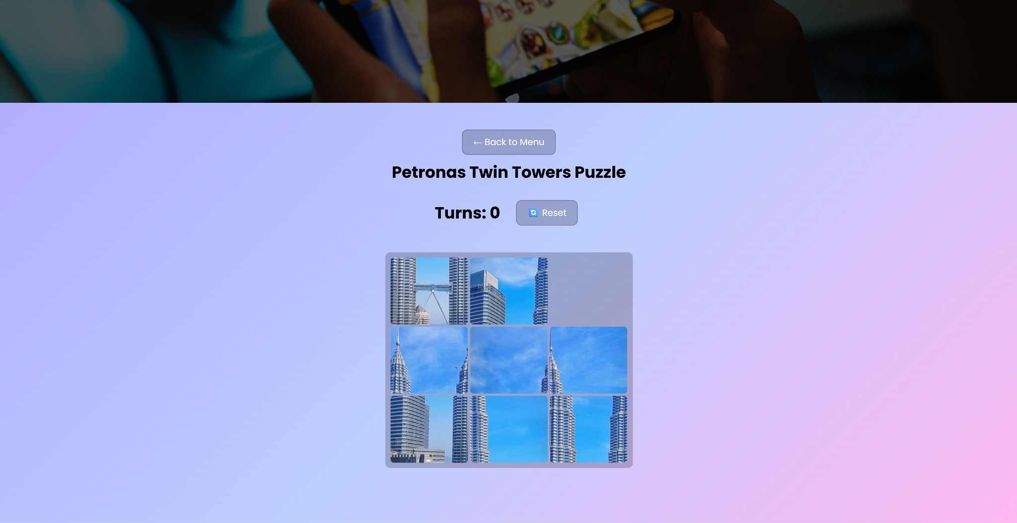

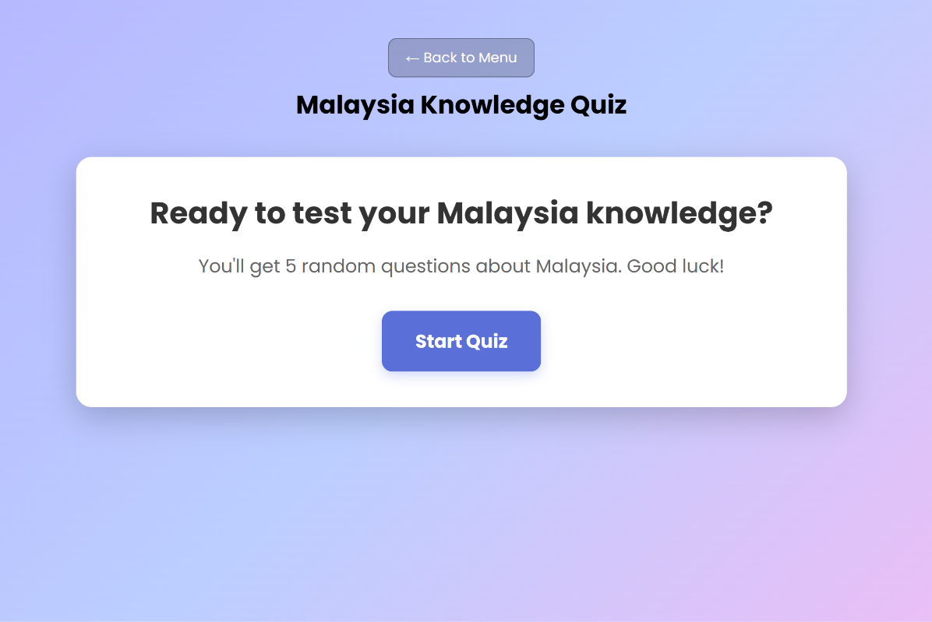
GAME
PUZZLE
MEMORY GAME
QUIZ

Slide 10
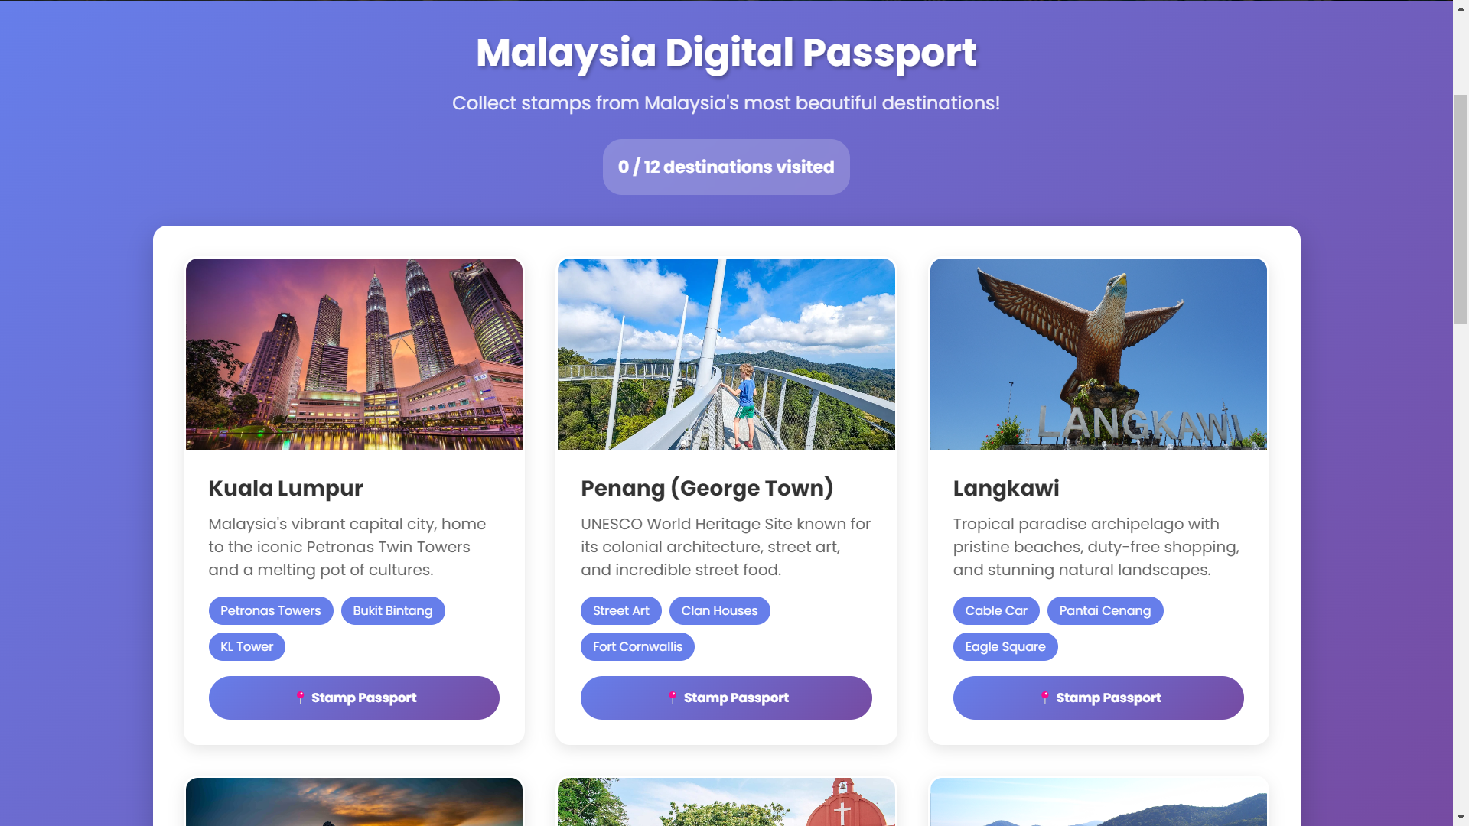
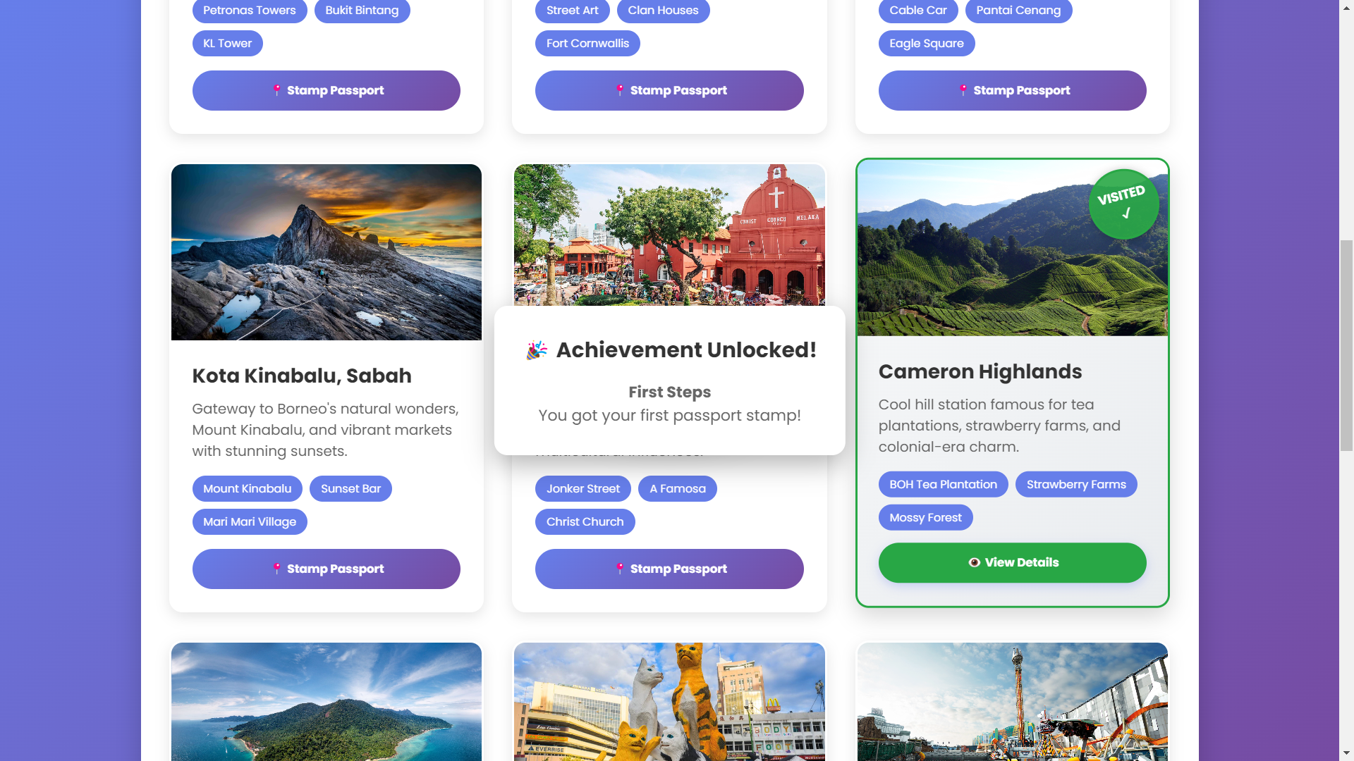
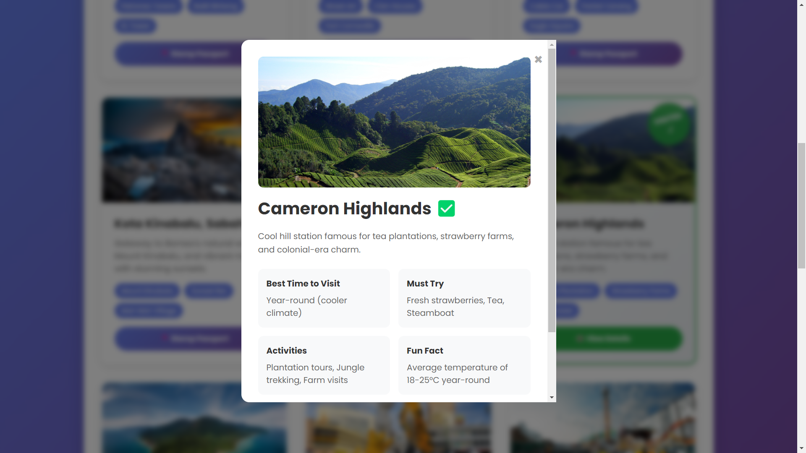
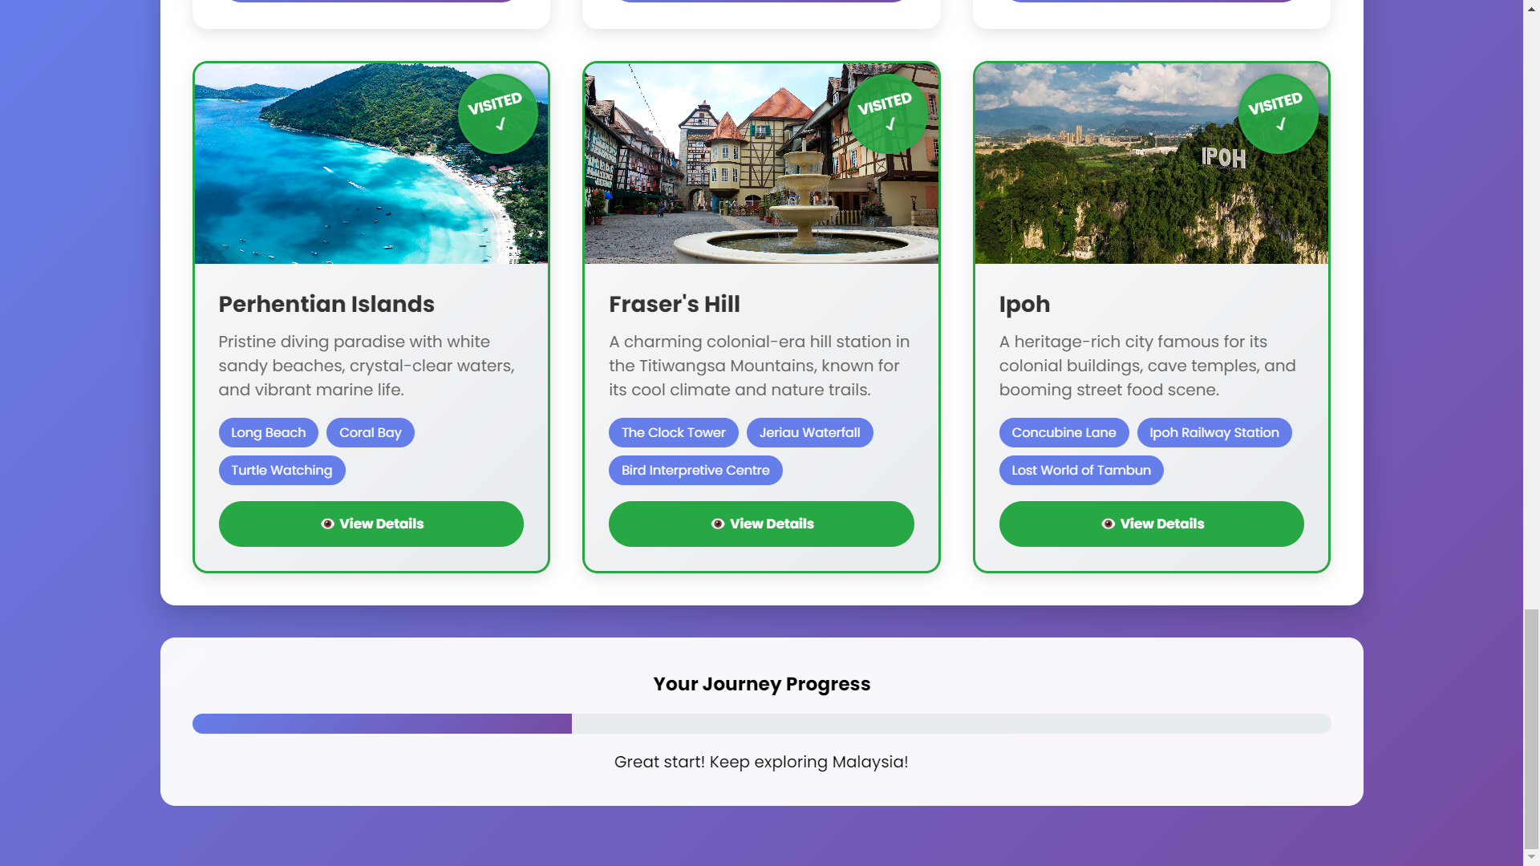
PASSPORT

Slide 11
THANK YOU

